Slide 1
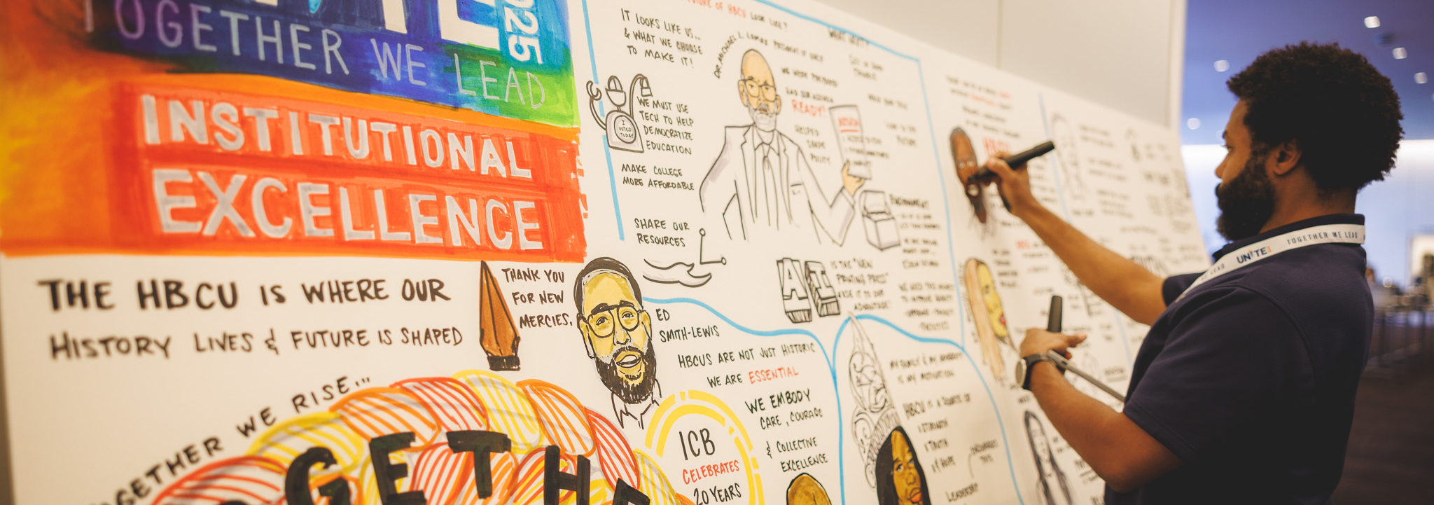


Updated
October 2025
SPONSORSHIP PROSPECTUS
Notes:
We look forward to partnering. Social Media plug. Save the date July 28 to August 1. We will open registration Jan 2024. If you are interested in sponsoring please reach out to Dr. Kendra Sharp.

Slide 2

TOGETHER WE LEAD

Slide 3
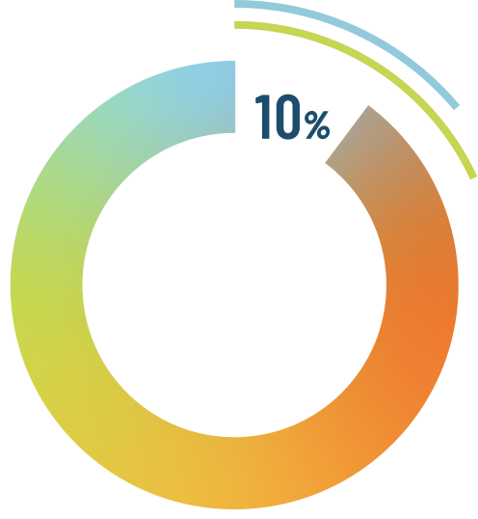

Academic Performance:
The 101 HBCUs across 19 states represent only 3% of all higher education institutes, yet…
They enroll 10% of all Black students.
They confer to Black students:
16% of all bachelor’s degrees
18% of all STEM degrees
The Outsized Impact of HBCUs
Return-On-Investment:
HBCUs create $16.5 billion in total economic impact, generating more than 136,000 jobs for local and regional economies.
Every dollar an HBCU and its students spends generates $1.43 in spending for its local and regional economies.
$1.43
$1
57%
Lifetime Earnings and Social Mobility:
HBCU Graduates: 51% more likely than peer Black graduates to move into a higher-income quartile.
HBCU Graduates: Earn 57% more than they could without these college credentials.
An HBCU graduate working full-time can expect
to earn $1,036,403 in additional income.
51%

Slide 4
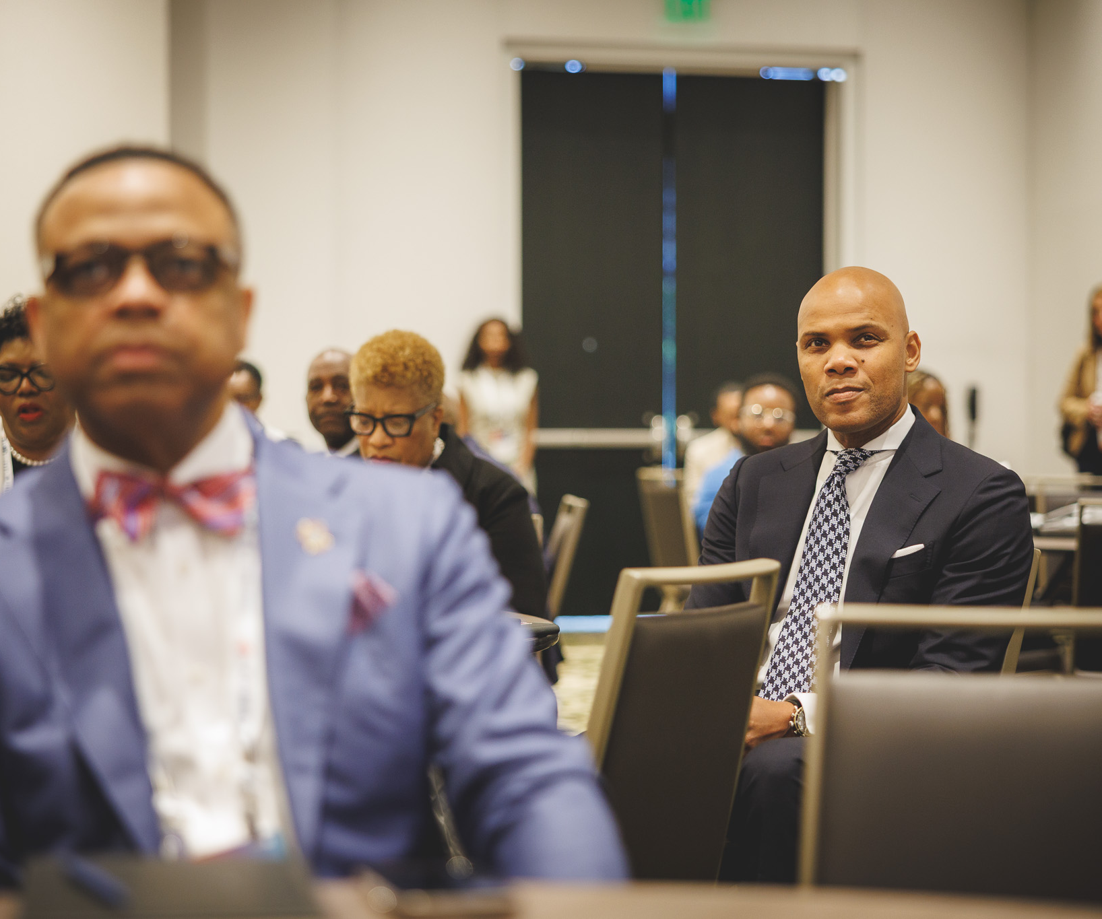
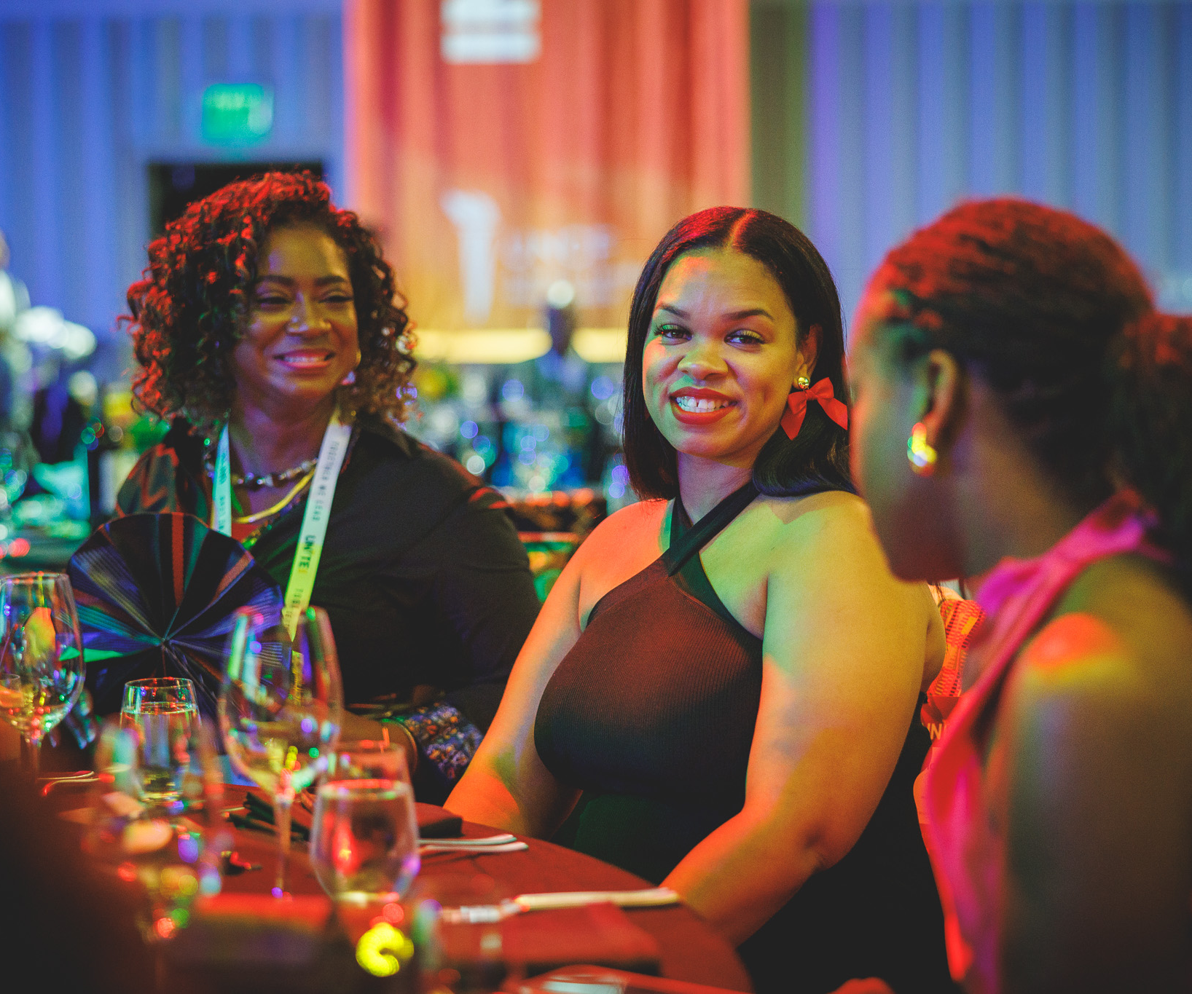
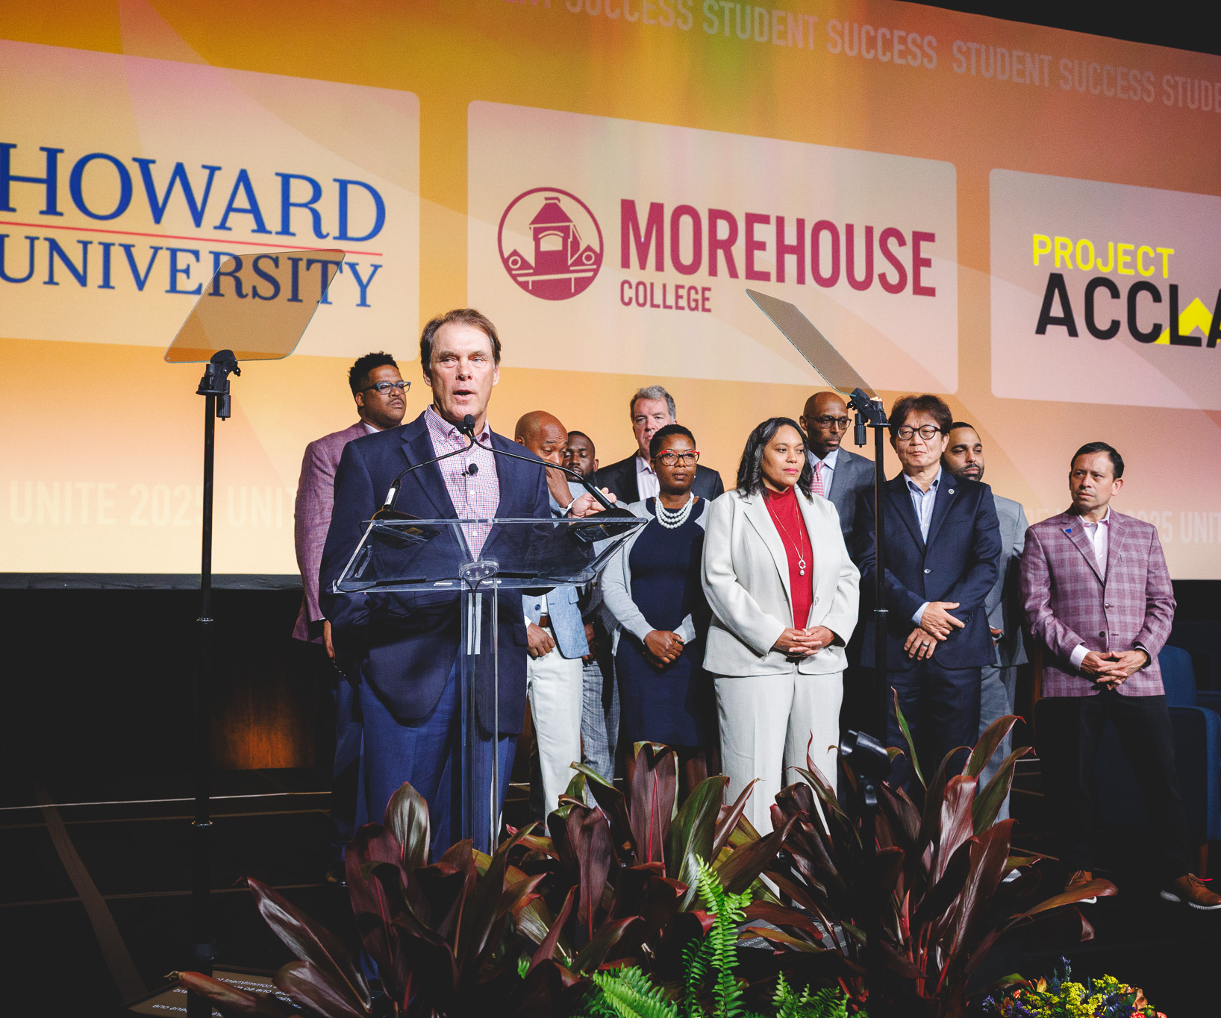
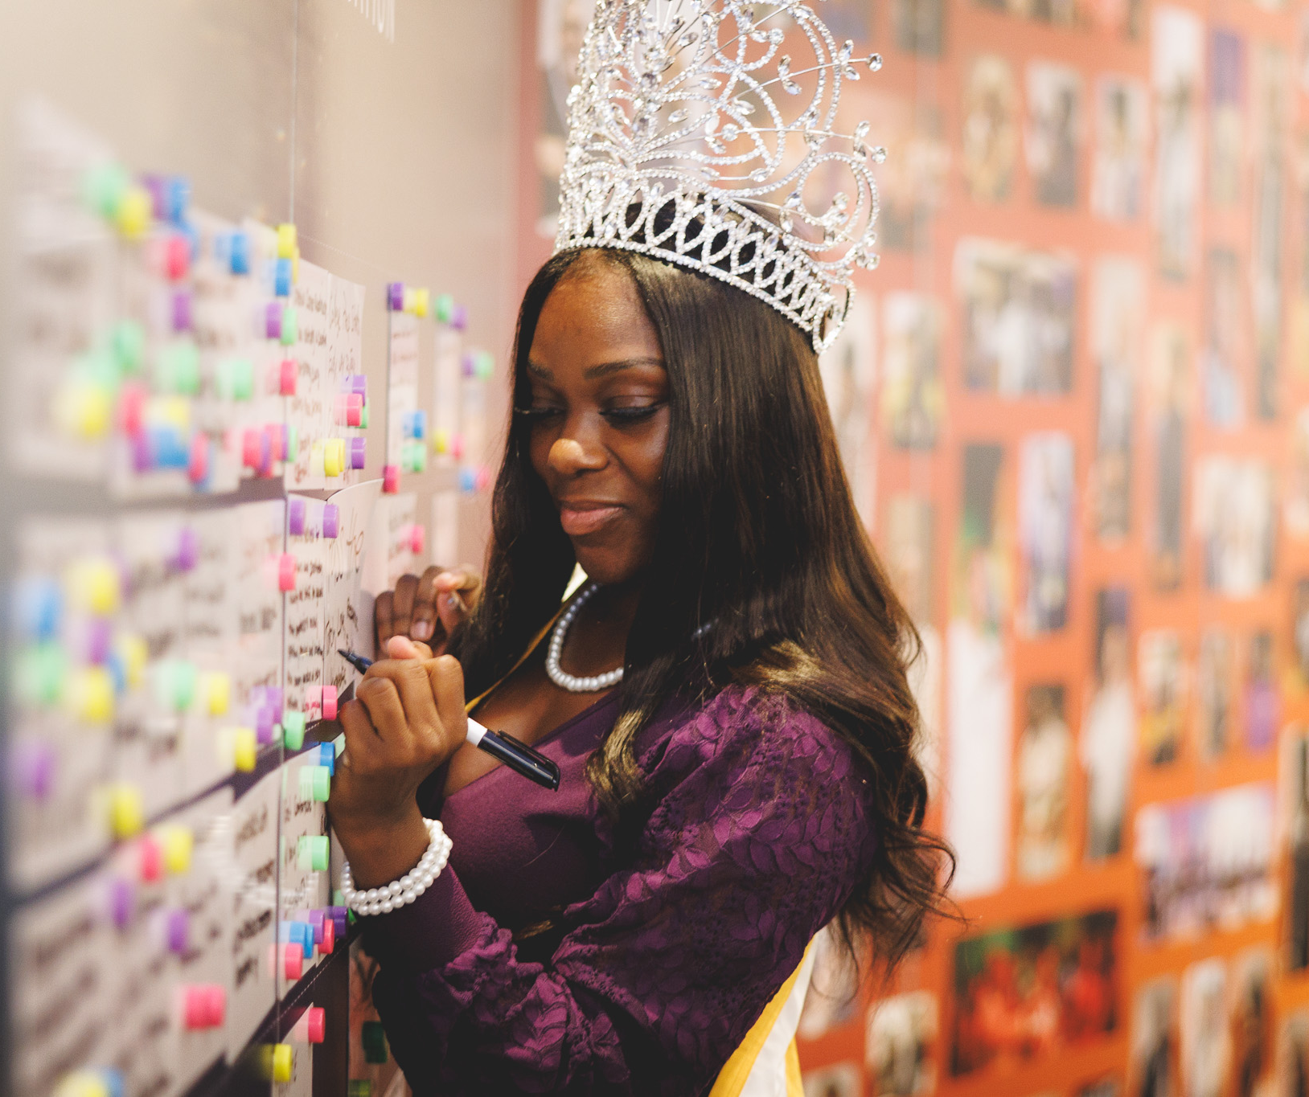
SAVE THE DATE
July 19 – July 23
Signia by Hilton | Atlanta, GA

Slide 5
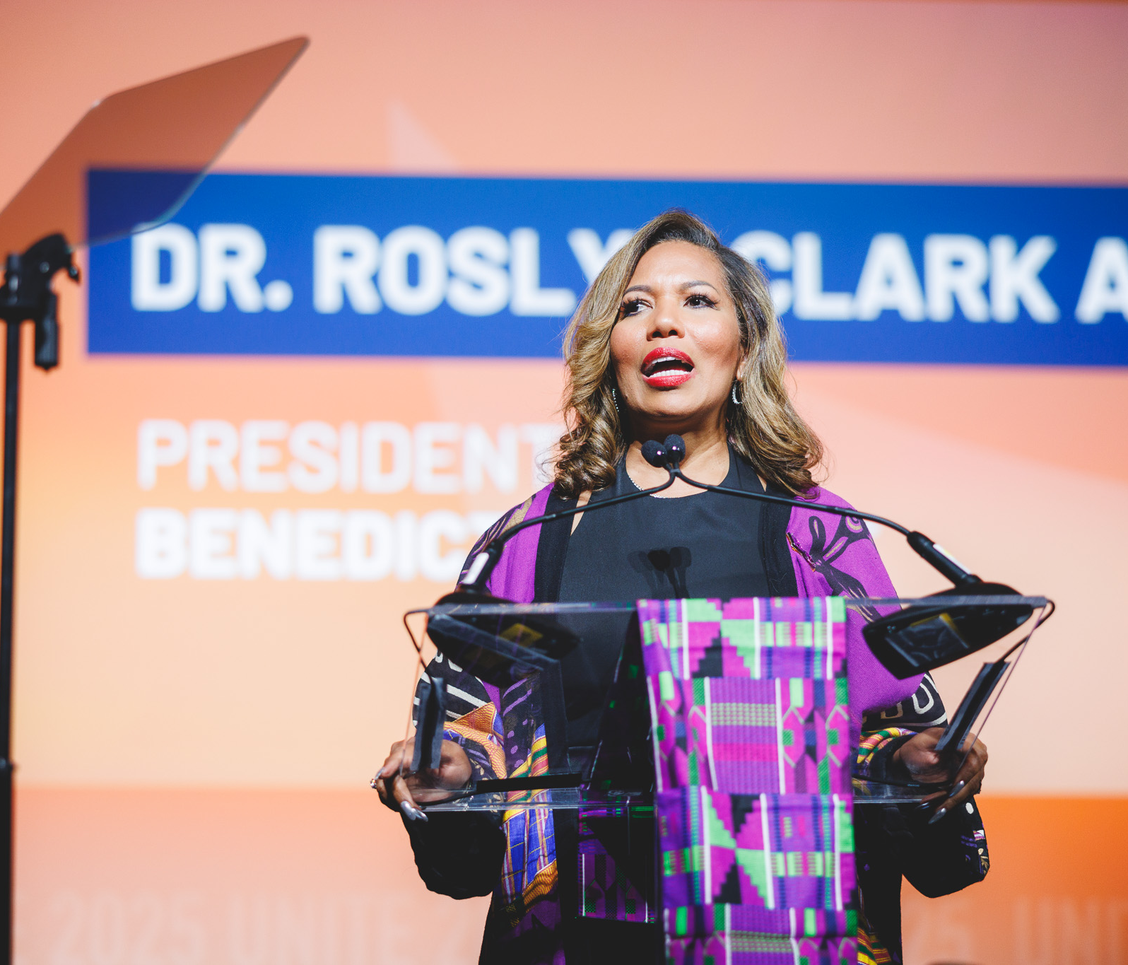


WHY SPONSOR
Align with a national organization with a proven commitment to HBCUs, educational equity and
racial justice.

Slide 6







UNITE 2026
UNCF PROGRAMMING PARTICIPANTS
COMPREHENSIVE SUPPORT FOR HBCUS AND THEIR STAKEHOLDERS
At UNCF, we understand that the success of HBCUs requires a holistic approach—one that supports not just institutions, but also the students, faculty, leaders, and communities they serve.
UNITE 2026 will bring together every dimension of UNCF’s programming, offering a 360-degree perspective on how we advance equity, innovation, and sustainability across the HBCU ecosystem.
Through scholarships, research, advocacy, capacity building, and teaching innovation, UNCF is uniquely positioned to align national resources with institutional priorities. From strengthening the leadership pipeline to elevating public policy, from advancing STEM pathways to enhancing K–12 access, our collective programming demonstrates the breadth and depth of support that empowers HBCUs to thrive today and lead into the future.
This integrated approach ensures that HBCUs—and the students and families they serve—have access to the tools, data, and networks required to drive transformative change and deliver lasting impact.

Slide 7
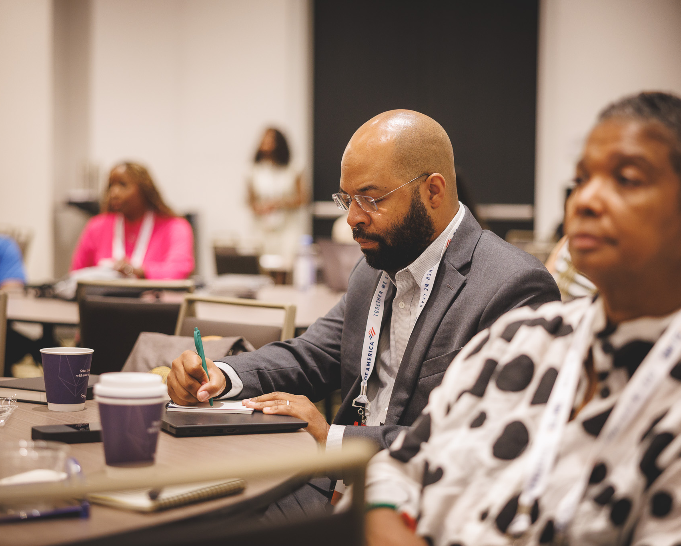


WHY SPONSOR
Invest in Black
higher education’s advancements in institutional excellence, student success, research and innovation, economic mobility
and systems change.

Slide 8
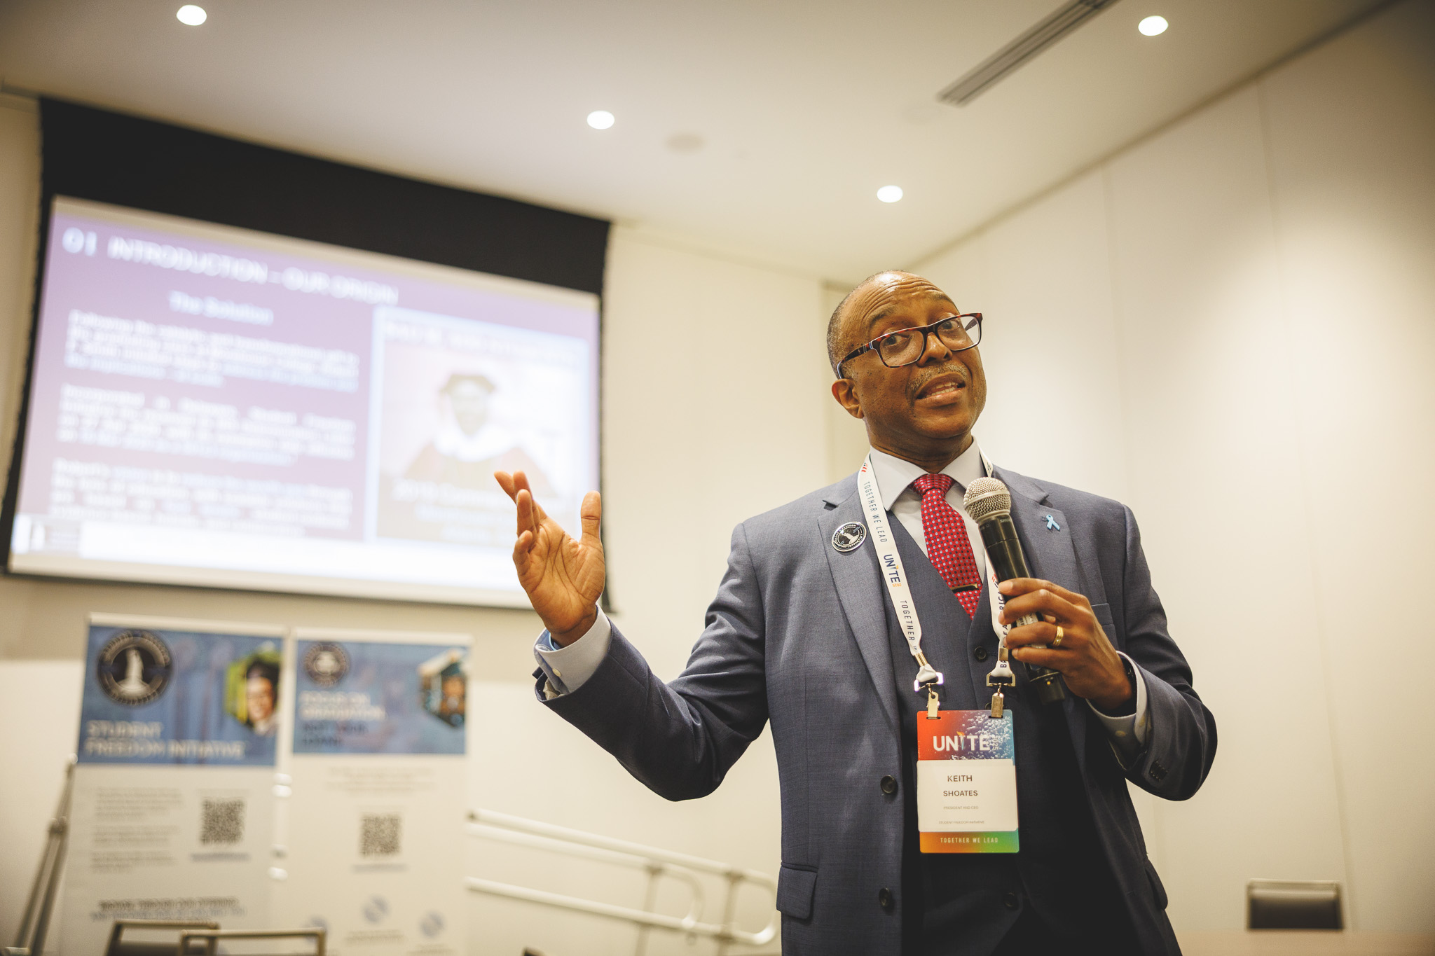

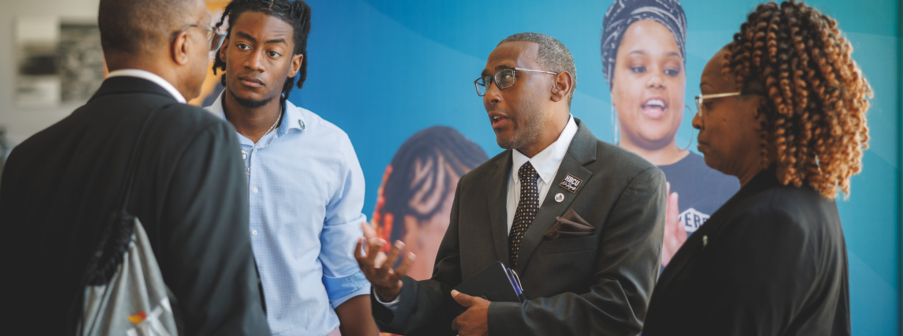
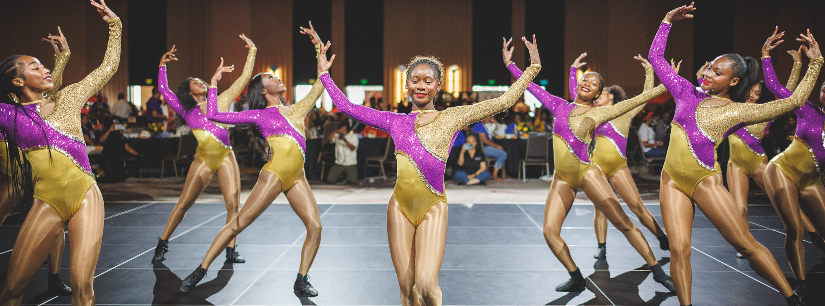
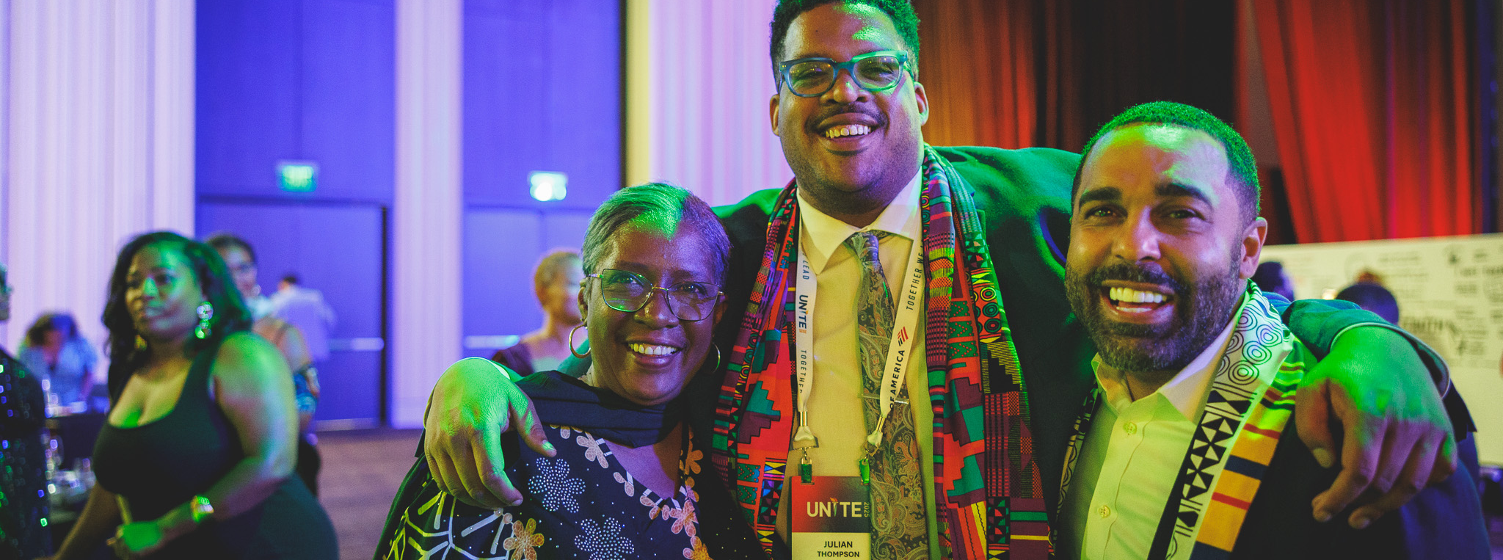
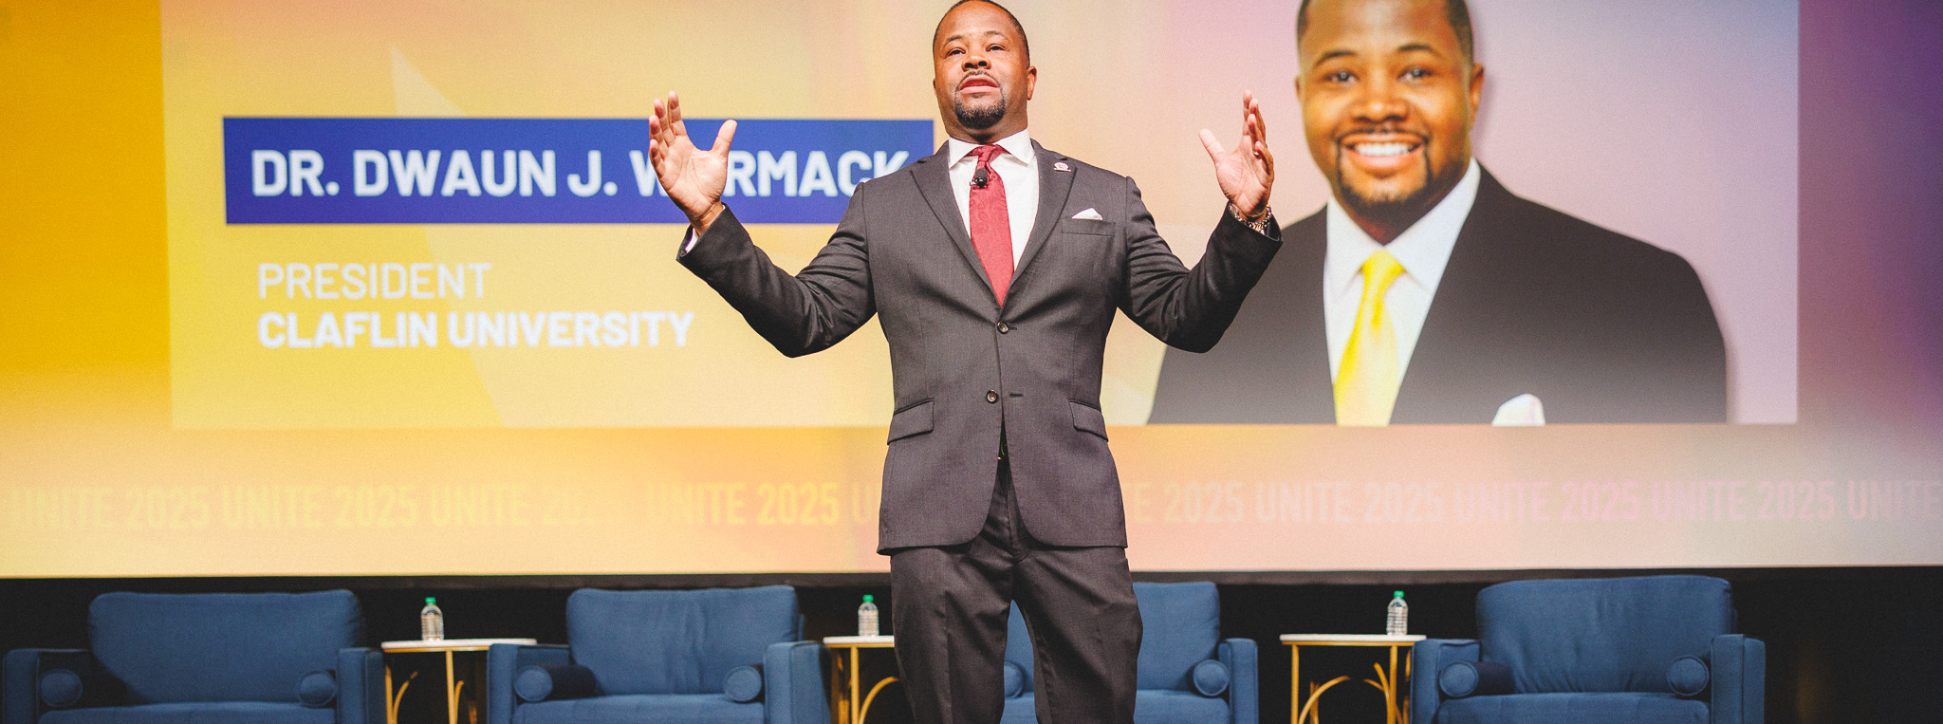
INSTITUTIONAL EXCELLENCE
Collaborate with institutional changemakers to unlock strategies that expand the skills and capabilities needed to lead in a rapidly evolving landscape.
STUDENT SUCCESS
Empower faculty, staff, and innovators to elevate student learning while ensuring every learner maximizes the value of their higher-education journey.
5
RESEARCH AND INNOVATION
Harness the power of artificial intelligence, big data, and emerging technologies to accelerate discovery, transform digital learning, and strengthen institutional research and evaluation.
GUIDING PILLARS
ECONOMIC MOBILITY
Champion pathways that expand economic opportunity for students and partnerships that deepen collaboration between educators, industry leaders, and strategic partners.
Reaching across traditional lines of responsibility to present a comprehensive view of pressing issues
in higher education, the summit’s guiding pillars seek to advance the missions of HBCUs strengthening the entire higher education ecosystem.
SYSTEMS CHANGE
Leverage institutional leadership to spark transformation, dismantle barriers, and accelerate progress – on campus and beyond.

Slide 9
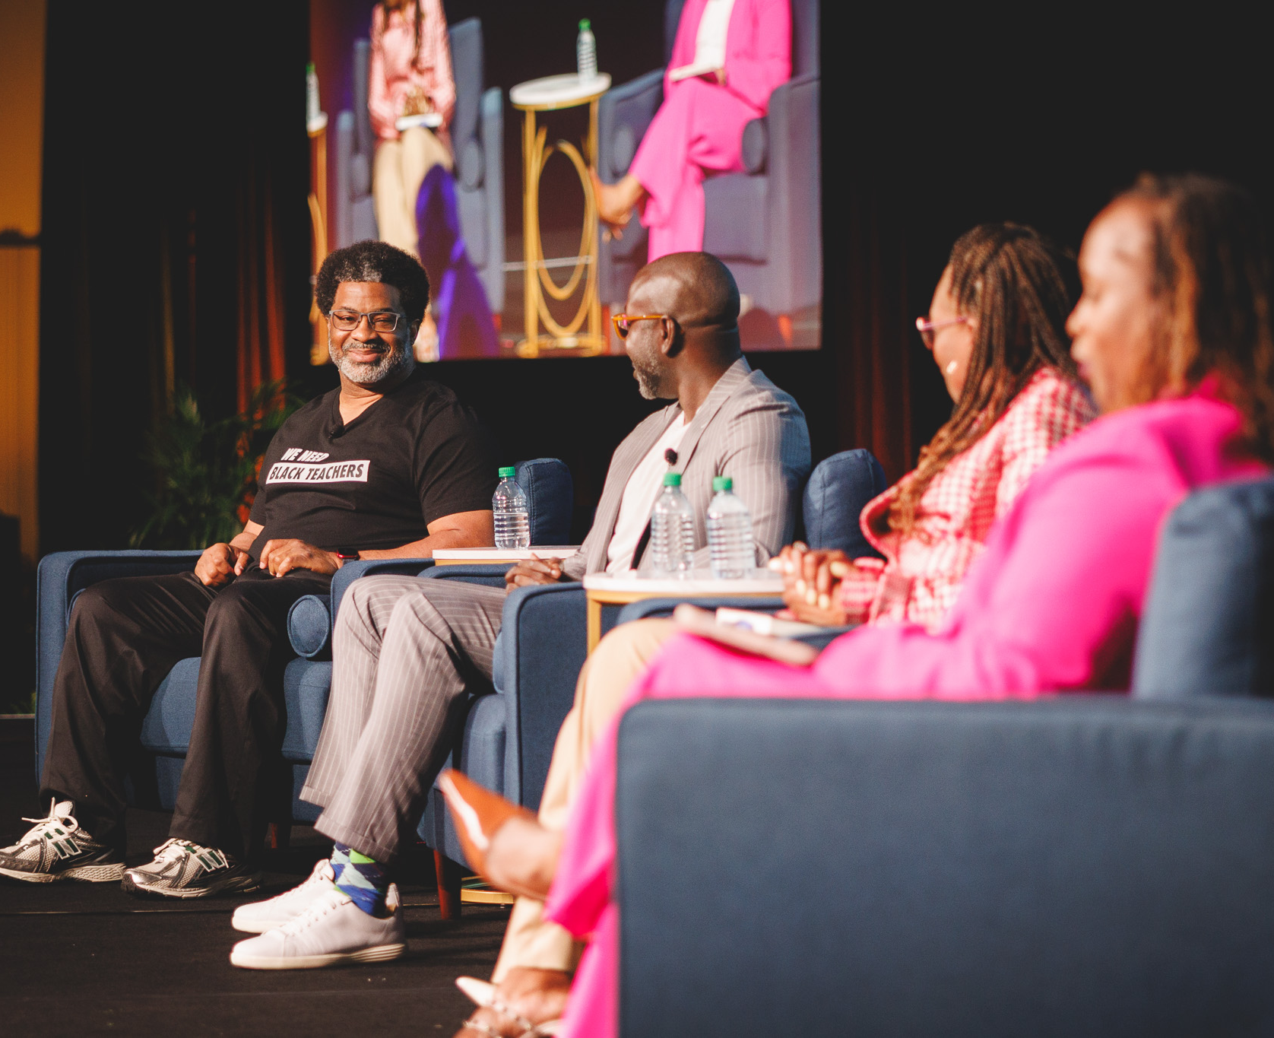

WHY SPONSOR
Access the largest
network of thought leaders, expert practitioners
and strategic partners transforming Black
colleges and universities.

Slide 10
UNITE 2025
BY THE NUMBERS
2025 Summit Attendees
Representing 85+ HBCUs/PBIs
1,384
38% HBCUs/PBIs
28% Non-Profit Organizations
16% For Profit/Philanthropic Organizations
13% Other
5% UNCF Staff
TOTAL REGISTRANTS
EXCELLENT/GOOD
Overall Summit Rating Given by
99% of Attendees
PROGRAMMING
70 Concurrent Sessions
25 Workshops & Meetings
25 Focus Areas
6 Plenary Sessions
5 Guiding Pillars
101 Education Institutions Represented
54 Presidents/Chancellors Registered

Slide 11
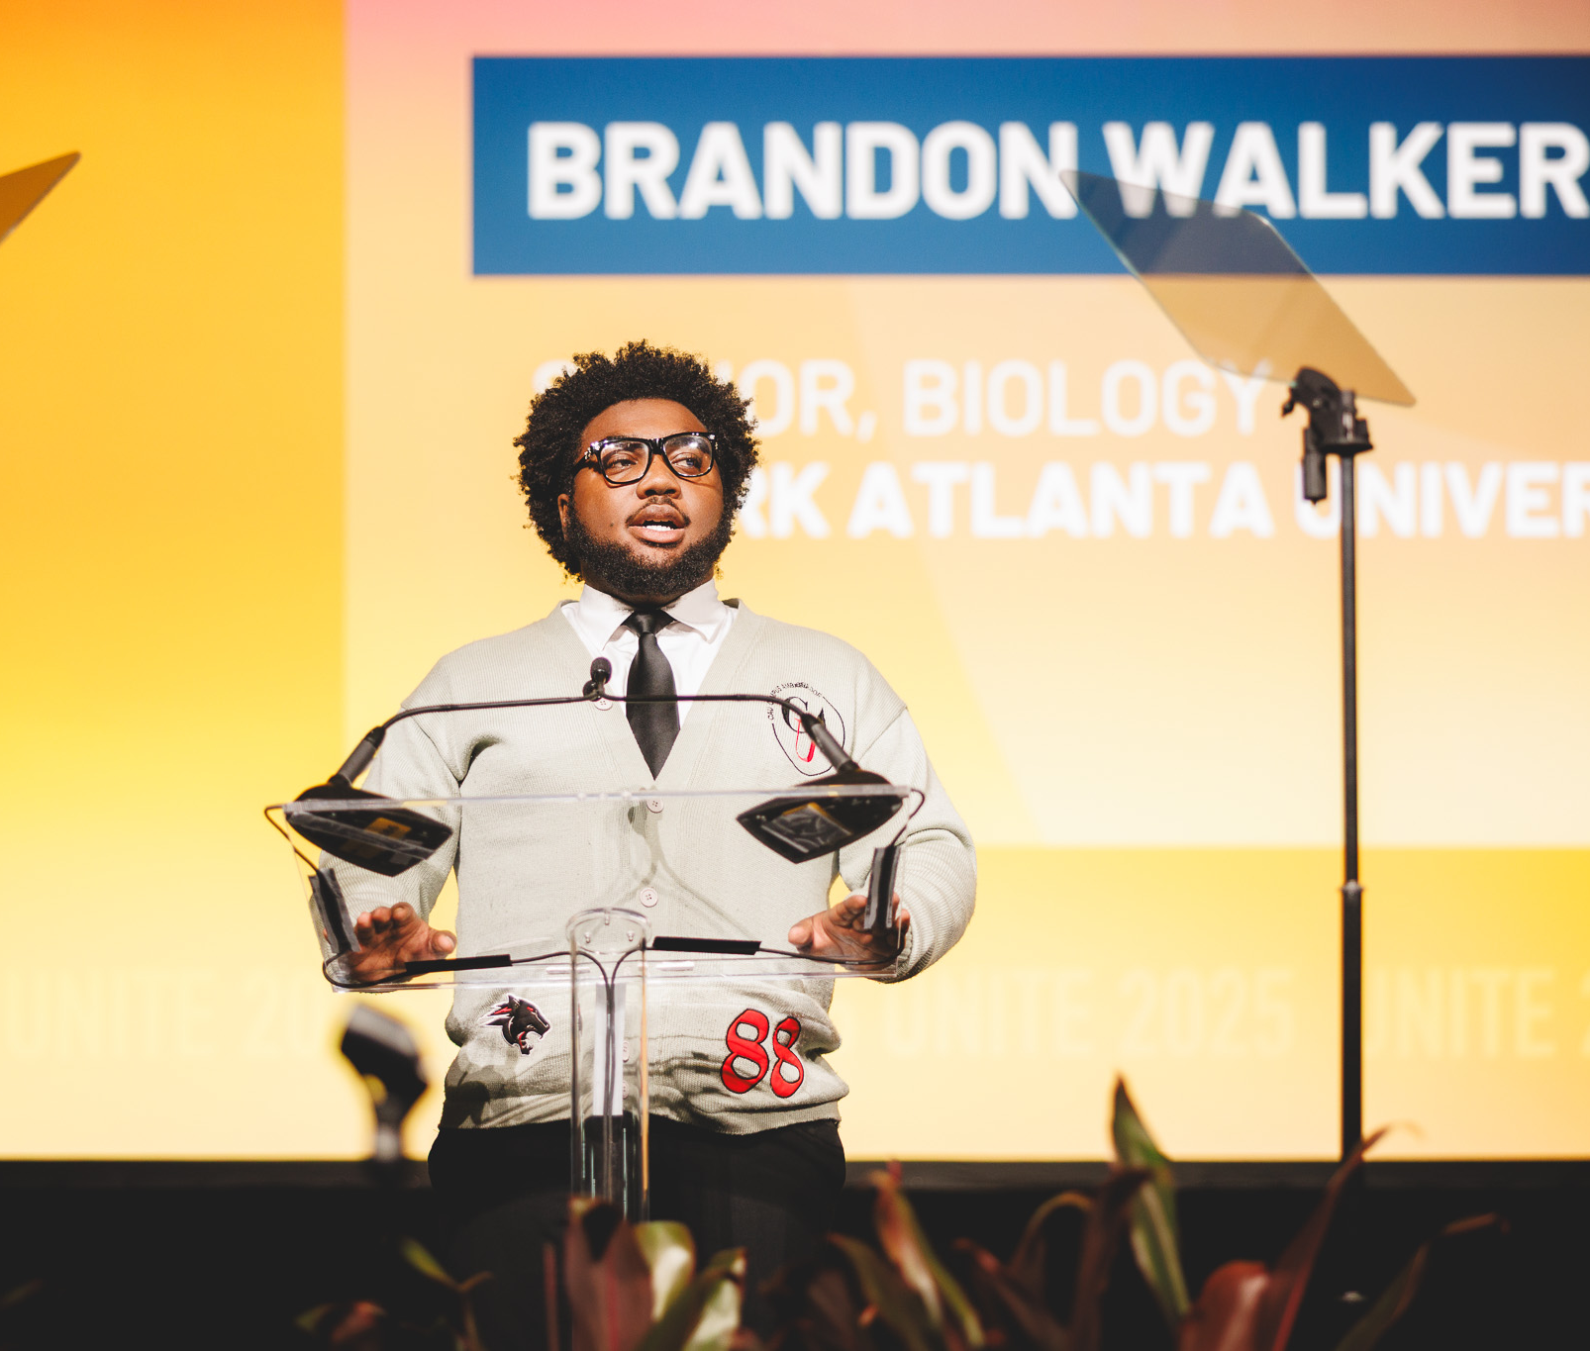

WHY SPONSOR
Support the proven and outsized impact of Black colleges and universities.

Slide 12



We seek to advance the transformation of all HBCUs
that serve nearly 300,000 students annually.
There are 102 Historically Black Colleges and Universities across the United States.

Slide 13
Step 1:
Select Sponsorship OPPORTUNITIES
to determine your Sponsorship LEVEL.
Step 2:
Review the preset Sponsorship BENEFITS of your Sponsorship LEVEL.
Step 3:
Contact us to finalize your sponsorship package and ensure the fulfillment of all opportunities and benefits:

Slide 14

& BENEFITS AT A GLANCE
STEP 2: Review the preset Sponsorship BENEFITS of your Sponsorship LEVEL.
GENERAL
FRESHMAN
SOPHOMORE
JUNIOR
SENIOR
PROFESSOR
$1,000-$4,999
$5,000-$9,999
$10,000-$24,999
$25,000-$49,999
$50,000-$99,999
$100,000+
CONTACT US
Logo Placement on UNITE Website
Early-Bird Discount for Additional Registrants
Group Recognition on Social Media
Item in Attendee Bags
Logo Placement on UNITE App/Website
VIP Reception Tickets (1)
2 Registrations
Early-Bird Discount for Additional Registrants
Group Recognition on Social Media
Item in Attendee Bags
Logo Placement on UNITE App/Website
VIP Reception Tickets (2)
5 Registrations
Early-Bird Discount for Additional Registrants
Item in Attendee Bags
Logo Placement on UNITE App/Website
Personalized Recognition on Social Media
VIP Reception Tickets (3)
5 Registrations
Access to Attendee Registration List
Dedicated Plenary or Main Stage Moment
Early-Bird Discount for Additional Registrants
Expo Hall Exhibit Booth
Item in Attendee Bags
Logo Placement on UNITE App/Website
Opening Gala Special Table Placement
Personalized Recognition on Social Media
VIP Reception Tickets (5)
All SENIOR Benefits
+
5 Additional Registrations
Breakout Space Engagement
Expo Hall Exhibit Booth
Opening Gala VIP Table
All PROFESSOR Benefits
+
UNITE 2026
Co-Branding
Pre-Event Media
Opportunities (Press Release)
HBCU Voices Podcast Interview
VIP Lodging Suite
Opportunities for Remarks

Slide 15

STEP 1: Select Sponsorship ACTIVITIES to determine your Sponsorship LEVEL.
Contact Us
PROFESSOR
$100,000+
SENIOR
$50,000-$99,999
JUNIOR
$25,000-$49,999
SOPHOMORE
$10,000-$24,999
FRESHMAN
$5,000-$9,999
GENERAL
$1,000-$4,999
$100,000 +
Mainstage Keynote Speaker
$75,000
Homecoming Sponsor
Presidents Reception
UNITE Guiding Pillar Plenary
$50,000
Co-Branded UNITE Attendee Bags
Community Announcement
Pre-Conference Session
Pre-Conference Reception
VIP Reception
$35,000
Afternoon Coffee w/ Executive Leaders
Customized Networking Reception
Happy Hour w/ Executive Leaders
UNITE Lanyards
UNITE Breakout Session
$25,000
Branded Charging Stations
Branded Massage Stations
Branded Networking Lounge
Hotel Key Cards
Professional Headshot Booth
Student Networking Session
$20,000
HBCU Voices Special Guest Episode
Sponsored Coffee Breaks
Sponsored Snack Breaks
Private Meeting Space
$15,000
Wi-Fi Login Screen
App Mobile Screen
Change Agent Award
Institutional Award
Post-UNITE Pillar Webinar
Sponsors Hall Exhibitor
$10,000
Faculty Mini Research Grant
HBCU Voices Soundbite Episode
Institutional Catalytic Grant
Practitioner Mini Grant
Pre-Summit Champion
$5,000
Branded Conference Evaluation
Homecoming Vendor Tent
Registration Scholarship
Wellness Activity

Slide 16
LEVEL:
FRESHMAN
CONTRIBUTION:
$5,000
OPPORTUNITIES:
Registration Scholarship
$5,000
LEVEL:
SOPHOMORE
CONTRIBUTION:
$20,000
OPPORTUNITIES:
Faculty Mini Grant
$10,000
Conference Evaluation
$5,000
Registration Scholarships
$5,000
LEVEL:
JUNIOR
CONTRIBUTION:
$35,000
OPPORTUNITIES:
Change Agent Award
$15,000
Pre-Summit Champion
$10,000
Homecoming Vendor Tent
$5,000
Conference Evaluation $5,000
LEVEL:
SENIOR
CONTRIBUTION:
$50,000
OPPORTUNITIES:
Branded Charging Stations
$25,000
Wi-Fi Log In Screen
$15,000
Practitioner Mini Grant
$10,000
LEVEL:
PROFESSOR
CONTRIBUTION:
$125,000
OPPORTUNITIES:
Presidents Reception
$75,000
Hotel Key Cards
$25,000
Branded Networking Lounge
$25,000

Slide 17

Conference Evaluations. Sponsor post-Summit conference evaluations. The organization’s logo will be visible on the conference evaluation form.
Customized Networking Reception. Host/sponsor a networking reception for a specific group. Includes signage and table set-up in visible area of event space and speaking opportunity.
Expo Hall Exhibitor. Signature booth in the UNITE expo hall to promote organizational brand. Signage, table, two chairs and a small trash can included.
Faculty Mini Research Grants. Sponsor a faculty research mini grant based on a specific area of subject expertise. Dissemination of grant opportunities will be handled by the ICB team.
General Coffee Breaks. Sponsor coffee breaks during one day of the summit. Branded signage will be placed in a visible area.
Happy Hour w/ Executive Leaders. Host an evening happy hour with a selection of attending HBCU/PBI executive leaders.
HBCU Voices – Soundbite Episode. Sponsor a recorded podcast episode. Includes a brief description of the sponsoring organization.
HBCU Voices – Special Guest Episode. Participate in the development of a podcast episode featuring a special guest from your organization. Includes a brief spotlight and description of your organization as the sponsoring partner.
Homecoming. Branding during the event. Remarks (5 mins) at the beginning of the event. Includes S&R signage. Opportunity to partner on homecoming activities or giveaways.
Homecoming Vendor Tent. Table to promote organizational brand during Homecoming.
Hotel Key Cards. Brand logo on hotel key cards alongside UNITE logo.
Institutional Catalytic Grant. Support a small grant to help HBCUs launch or scale innovative initiatives.
Institutional Awards. Sponsor an institutional award. Awardees will be selected by the ICB team by way of an internal voting process.
Massage Stations. Sponsor a Massage Station, providing attendees with relaxation while enhancing your brand's visibility and engagement.
Meeting Room. Sponsor meeting room space that will be utilized as an open space for attendees to rest and relax. Branded signage included.
App Mobile Screen. Brand logo on app log-in screen alongside UNITE logo.
Branded Charging Stations. Sponsor a portable charging station for attendees during the duration of the conference.
Branded Massage Station. Wellness-focused lounge branded by the sponsor, offering attendees chair massages during the event.
Branded Networking Lounge. Customizable lounge space where attendees connect, network, and recharge. Signage included.
Change Agent Award. Sponsor a change agent award. Awardees will be selected by the ICB team by way of an internal voting process.
Coffee w/ Executive Leaders. Afternoon coffee with a selection of attending HBCU/PBI executive leaders.
Community Announcement. Sponsor lunch session during one day of the summit. Branded signage will be placed in a visible area.

Slide 18
Private Meeting Space. Exclusive meeting space available for 1 hour to host private meetings and conversations.
Registration Scholarships. Sponsor travel or lodging for an aspiring UNITE attendee.
Student Networking Session. Host a student focused networking event. Branded signage included.
Sponsored Coffee Breaks. Sponsor coffee breaks during one day of the summit. Branded signage included.
Sponsored Snack Breaks. Sponsor snack breaks during one day of the summit. Branded signage included.
UNITE Attendee Bags. Brand logo on summit attendee bags alongside UNITE logo.
UNITE Breakout Session. Sponsor a breakout session aligned with your organization's expertise.
UNITE Guiding Pillar Plenary. Branding associated with one of the summit's guiding pillars. Signage in the visible area of event space, and logo on the main stage.
UNITE Lanyards. Brand logo on summit lanyards alongside UNITE logo.
VIP Reception. Host/sponsor reception for all VIP conference attendees. Includes signage and table set-up in visible area of event space and speaking opportunity.
Wellness Programming. Sponsor wellness activity for UNITE attendees. (i.e., yoga, meditation, morning walk session)
Wi-Fi Login Screen. Brand logo on WIFI log-in screen alongside UNITE logo.
Post-UNITE Webinar. Host a post-UNITE 1 hour webinar in alignment with one of the UNITE CTAs.
Practitioner Mini Grants. Sponsor a practitioner research mini grant based on a specific area of subject expertise. Dissemination of grant opportunities will be handled by the ICB team.
Pre-Conference Reception. Host/sponsor reception for all pre-conference attendees. Includes signage and table set-up in visible area of event space and speaking opportunity.
Pre-Conference Session. Sponsor one of the pre-conference sessions. Includes signage and table set-up in visible area of event space and speaking opportunity.
Professional Headshot Booth. Sponsor a headshot booth for attendees during one day of the summit. Branded signage included.
Pre-Summit Champion. Recognition as a supporter of pre-conference programming. Signage not included.

Slide 19
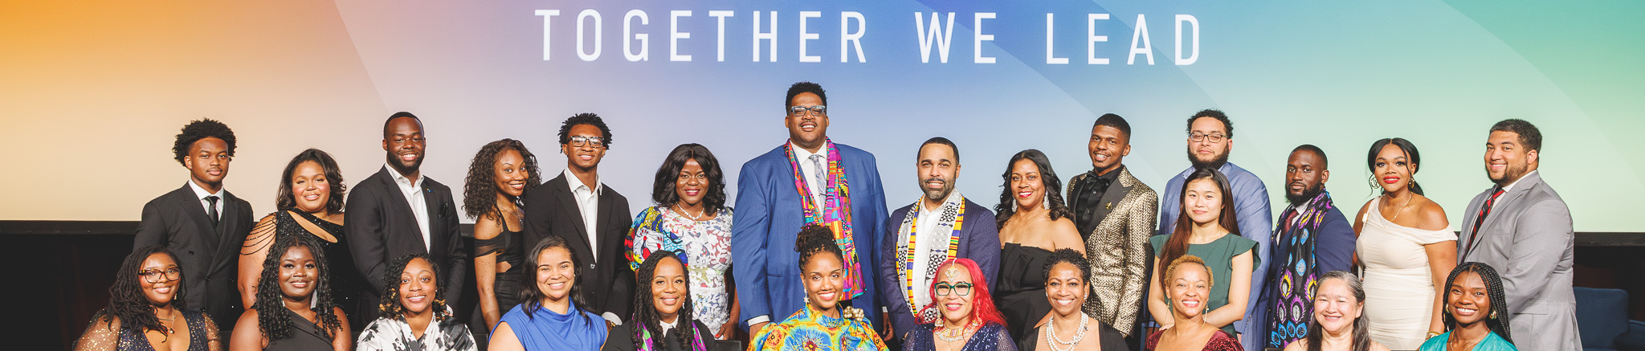






UNCF Institute for Capacity Building
245 Peachtree Center Ave NE, Suite 2800
Atlanta, GA 30303
uncfunite.org
Follow us on social media:
UNCF Institute for Capacity Building
UNCF Institute for Capacity Building
@UNCFICB
@UNCFICB
To finalize your sponsorship package and ensure the fulfillment of all benefits and opportunities: contact:
Dr. Kendra Sharp Deas: Kendra.Sharp@uncf.org
Julian Thompson: Julian.Thompson@uncf.org
Notes:
We look forward to partnering. Social Media plug. Save the date July 28 to August 1. We will open registration Jan 2024. If you are interested in sponsoring please reach out to Dr. Kendra Sharp.

